Slide 1

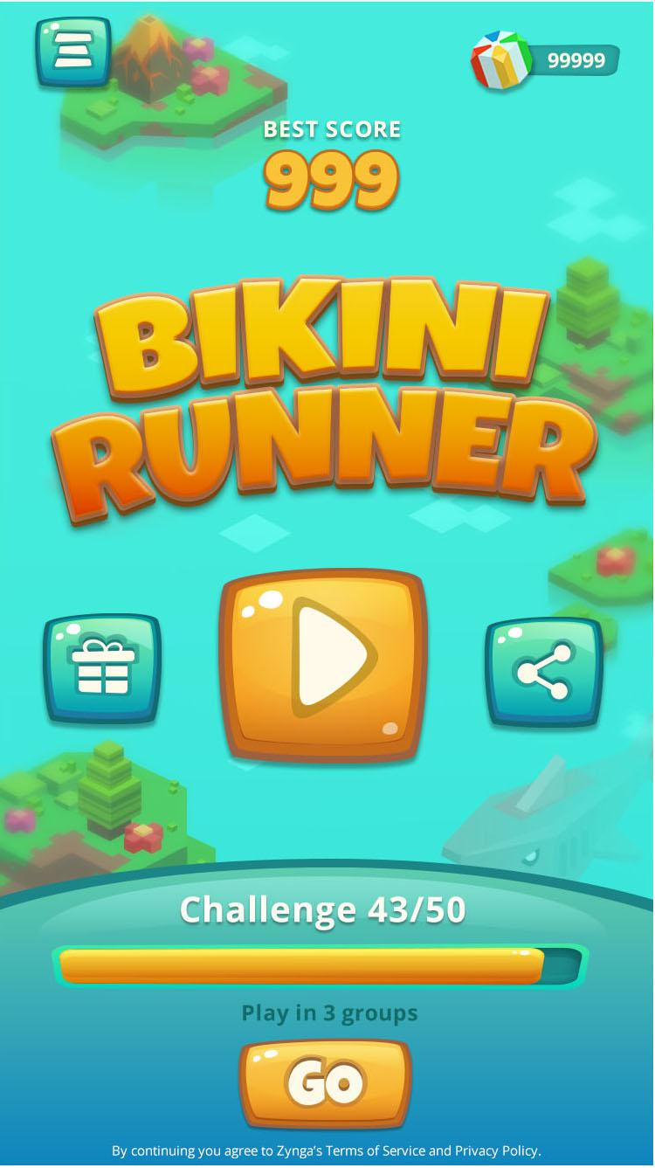
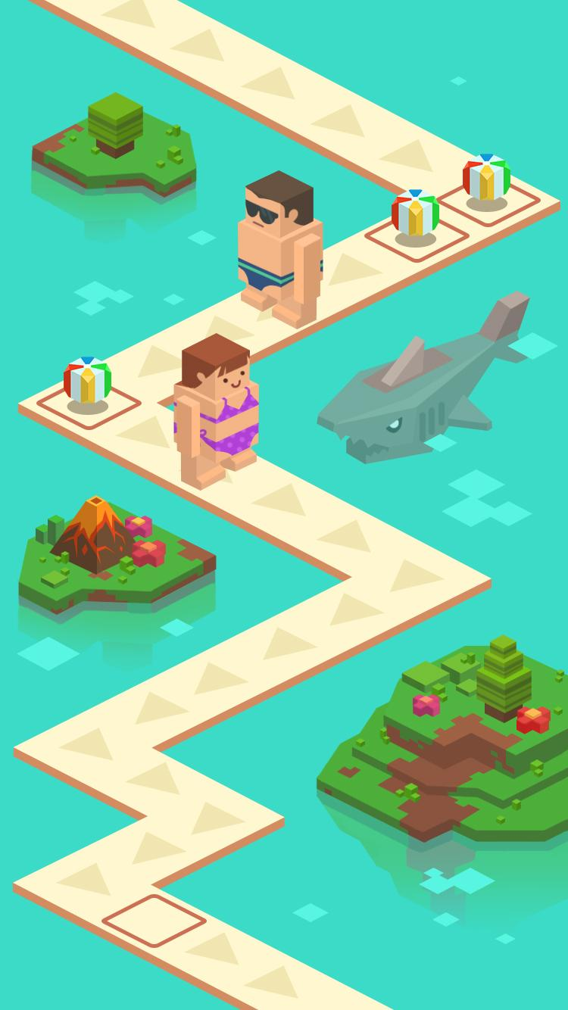
BIKINI RUNNER

Slide 2
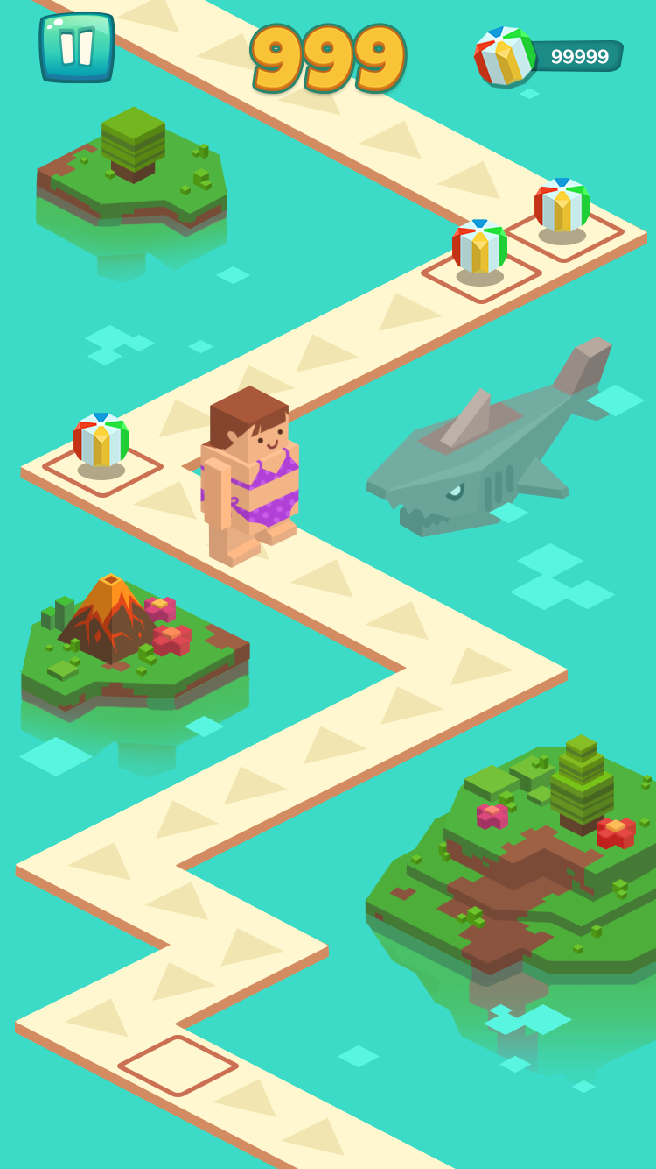







SAVE YOUR SKIVVIES!
Endless Platformer
Jump over obstacles & collect Beach Points
Full Health
1 Hit
Game Over

Slide 3
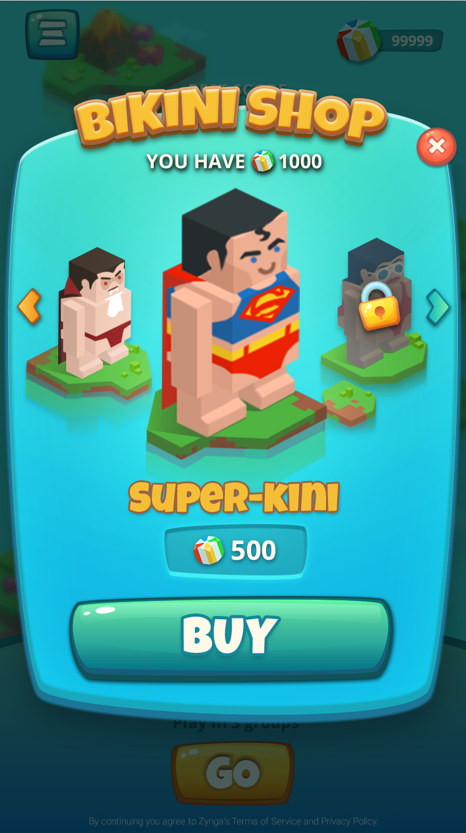





SPEND @ THE BIKINI SHOP
Use Beach Points to purchase new runners!

Slide 4
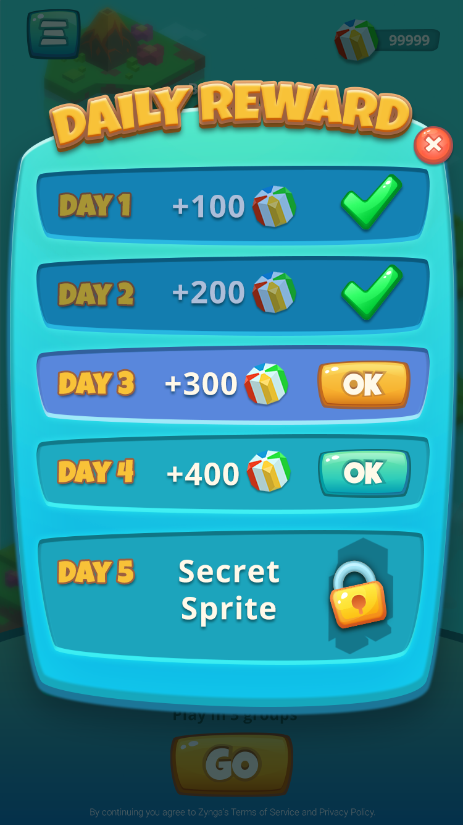
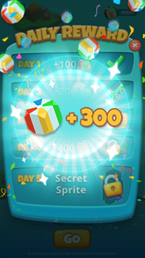
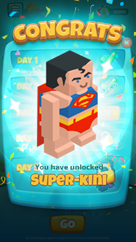
GET REWARDED FOR KEEPING ACTIVE
Hourly Drip & Daily Streak

Slide 5
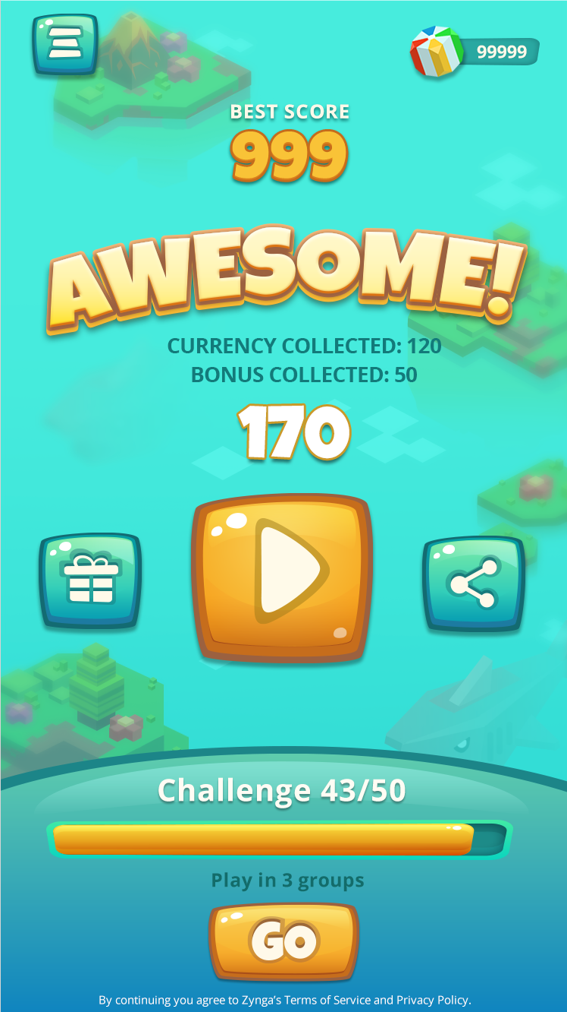
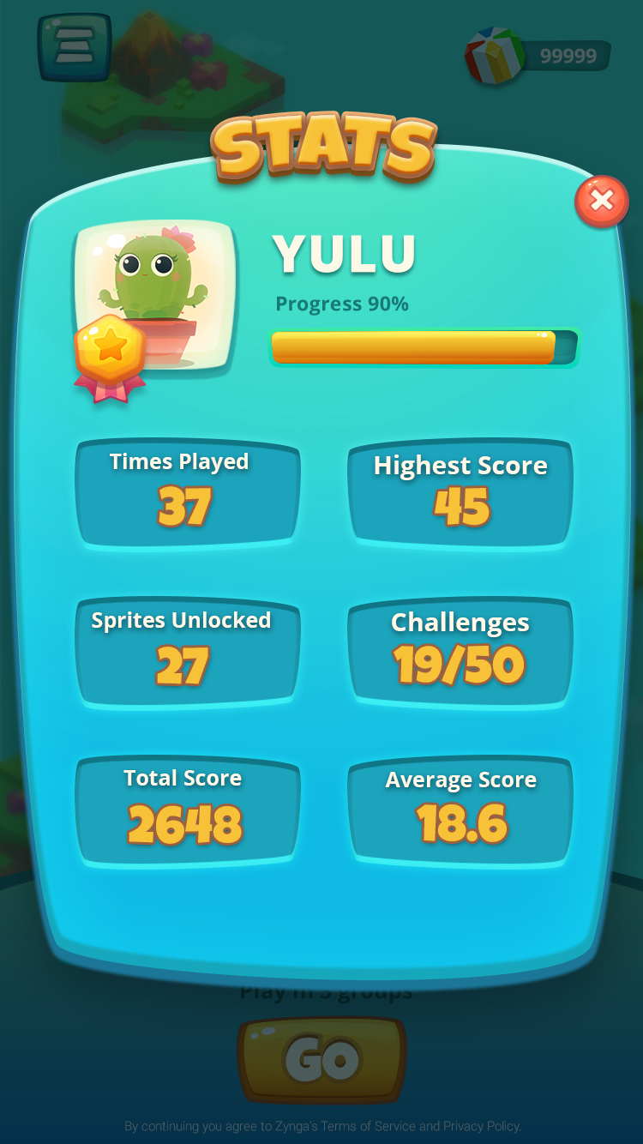
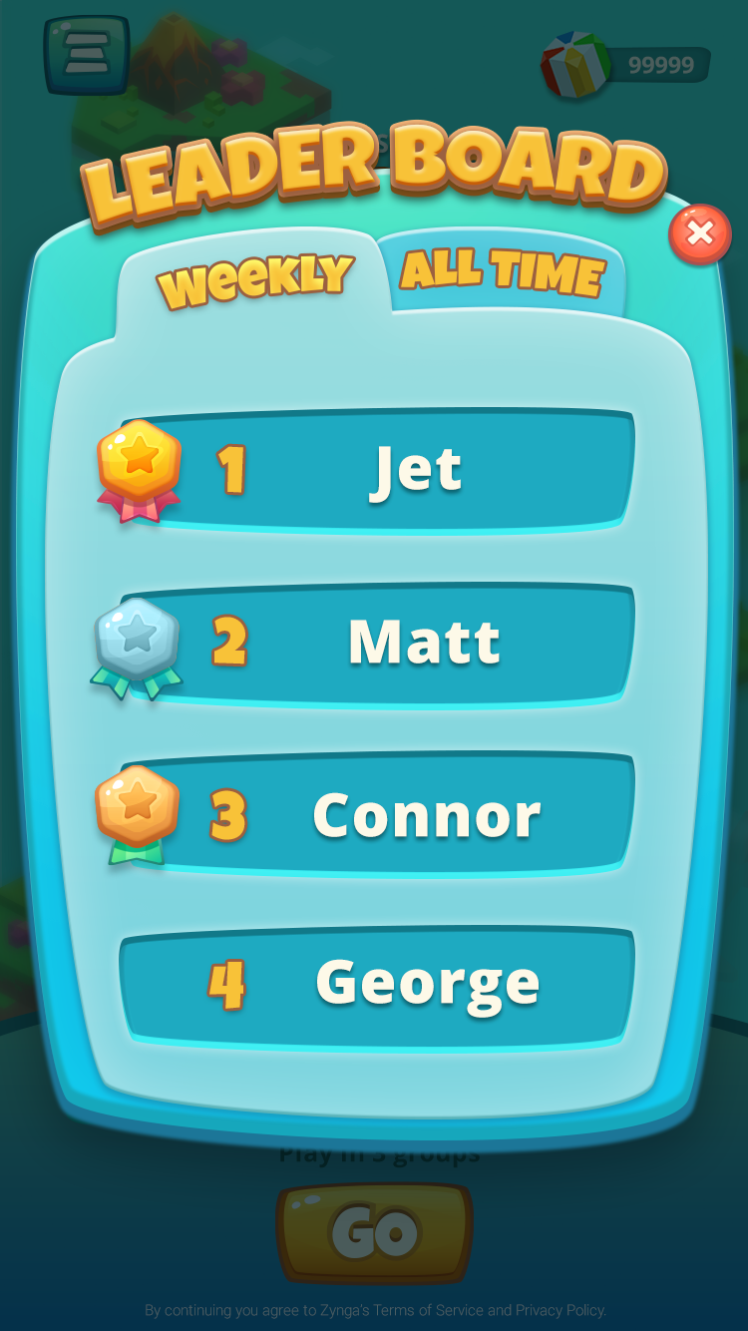
STAY #WOKE ABOUT STATS
Game Results, Personal Stats, & Leaderboards

Slide 6

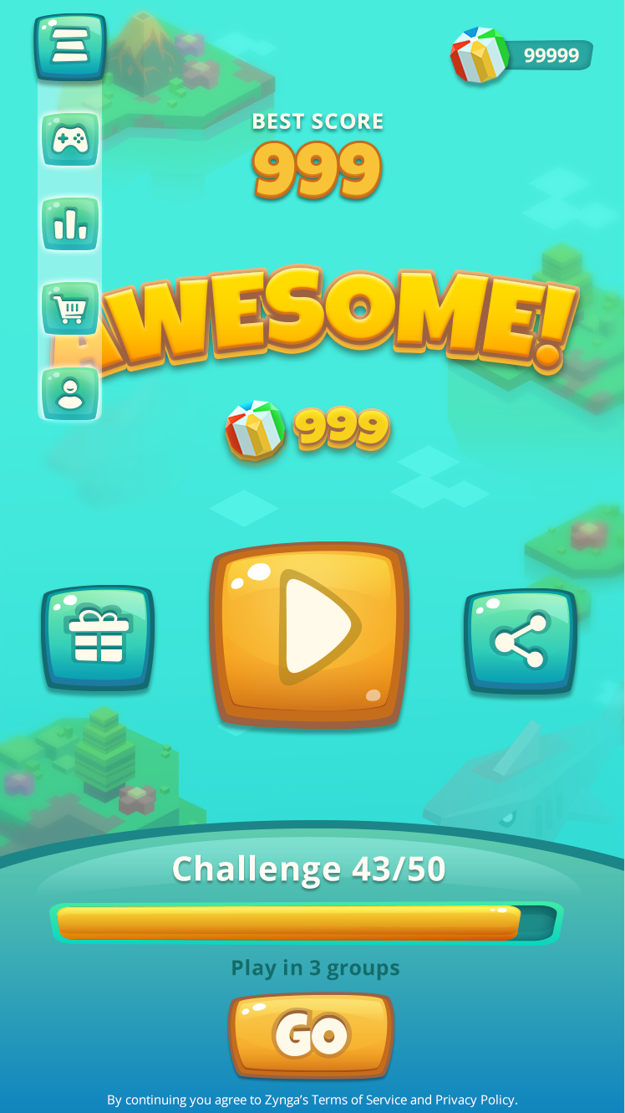
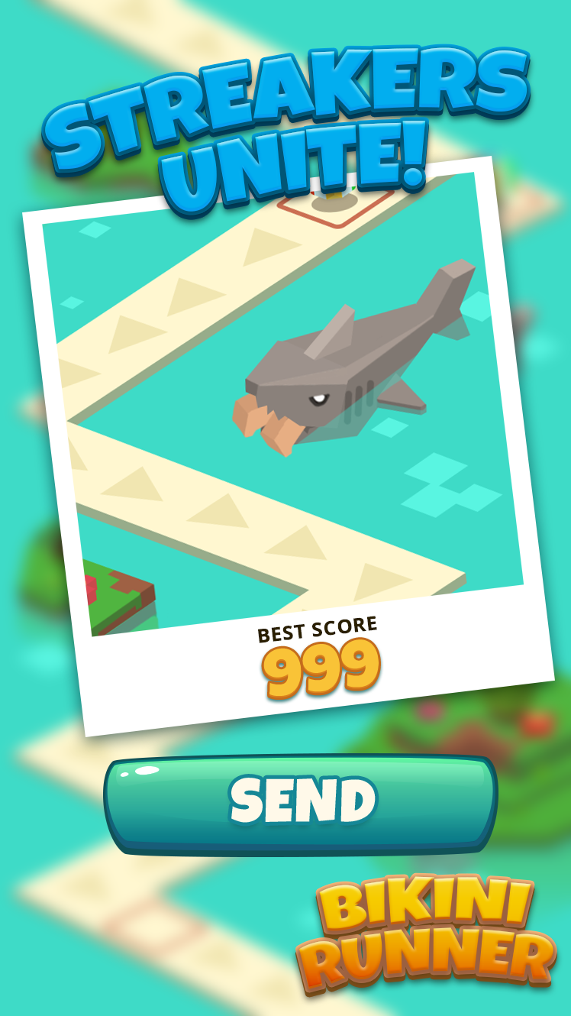
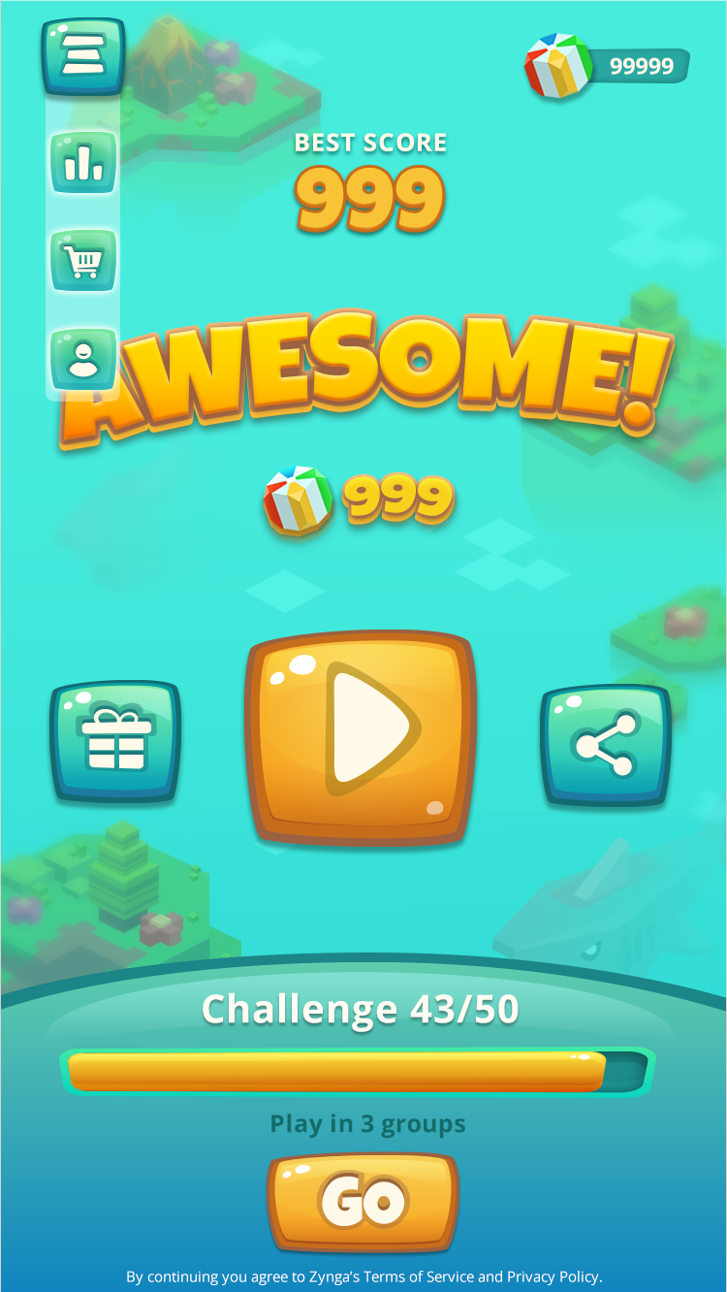
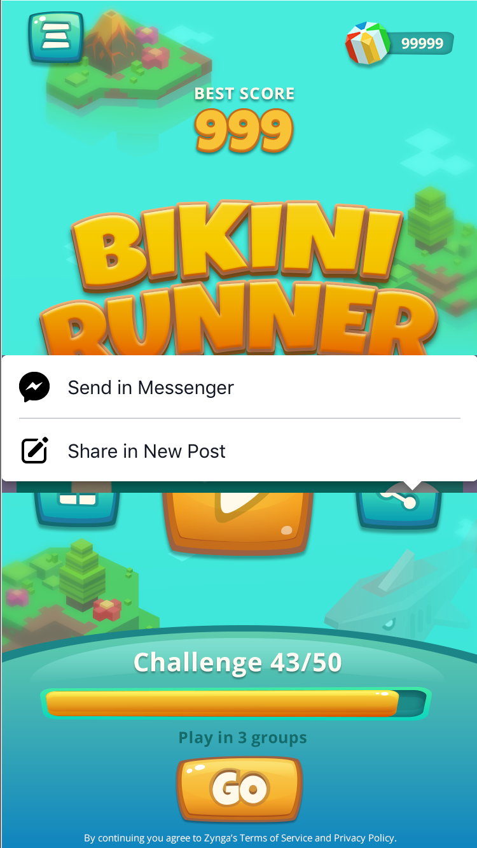
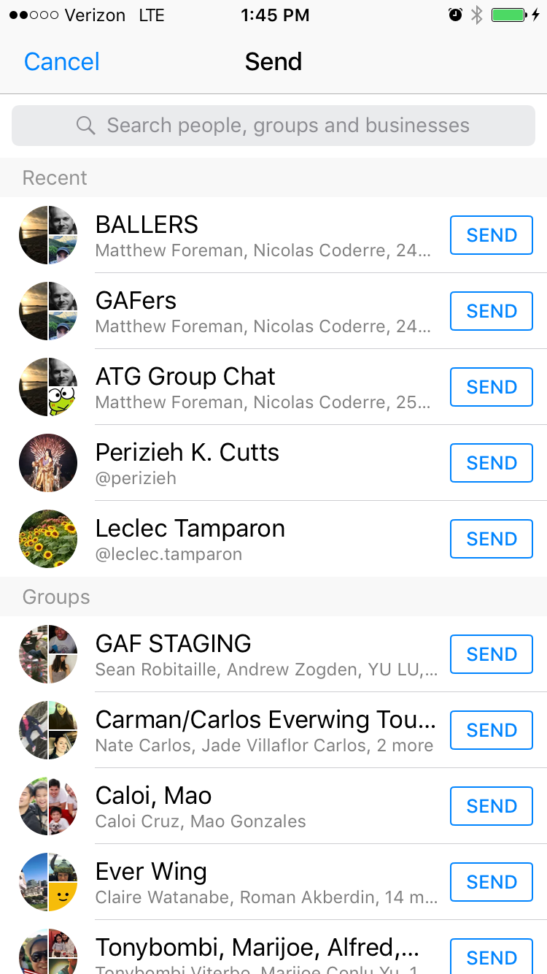
SHARE WITH WITH YOUR FRIENDS
Photos complete with getting eaten by sharks and mild nudity.

